Slide 1


2024
Localization, navigation and smart mobility project
Jiaheng Xiong

Slide 2
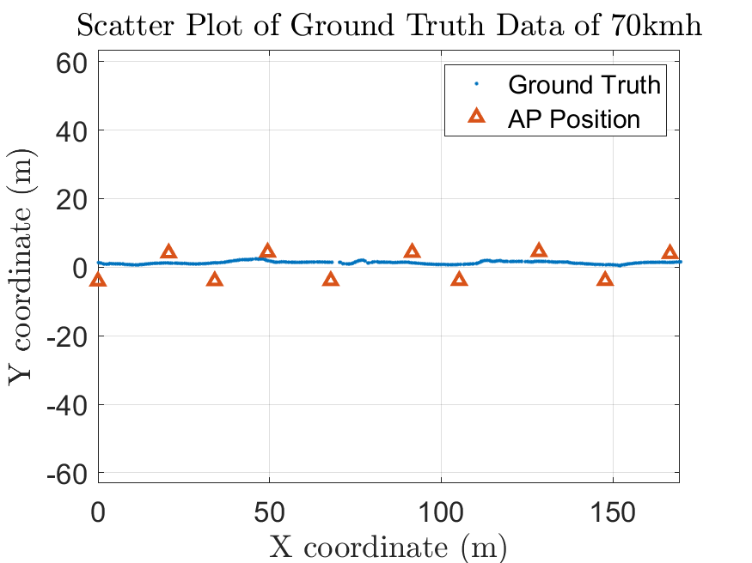
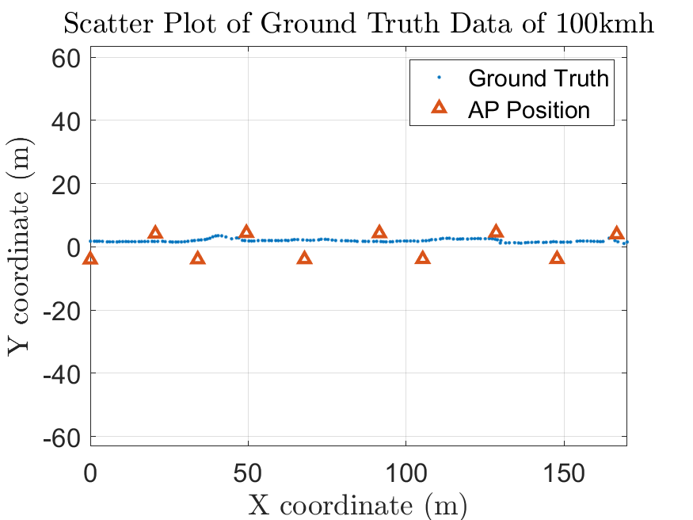
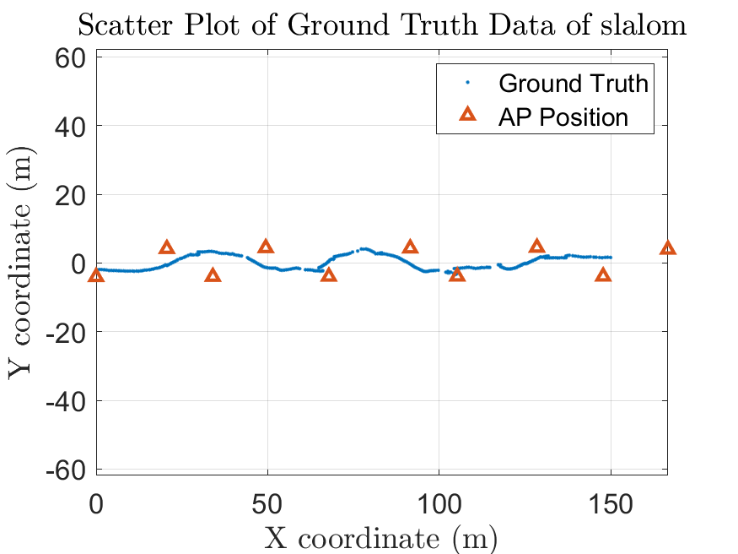

Data Visualization
Firstly, we visualize the ground truth for 3 dataset.
Jiaheng Xiong - DEIB

Slide 3
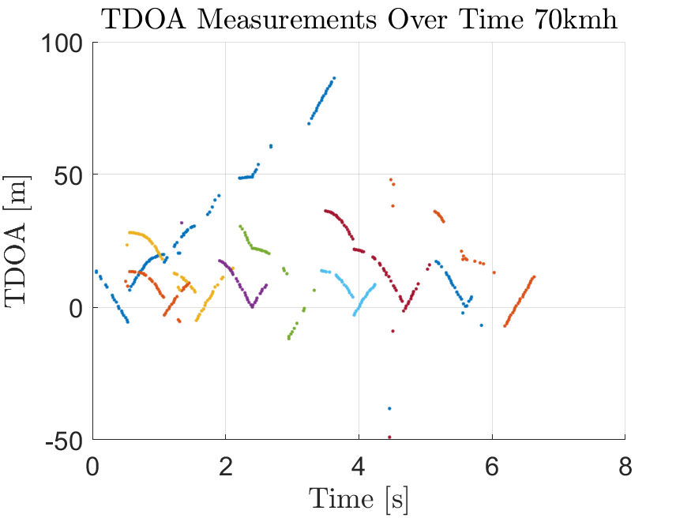
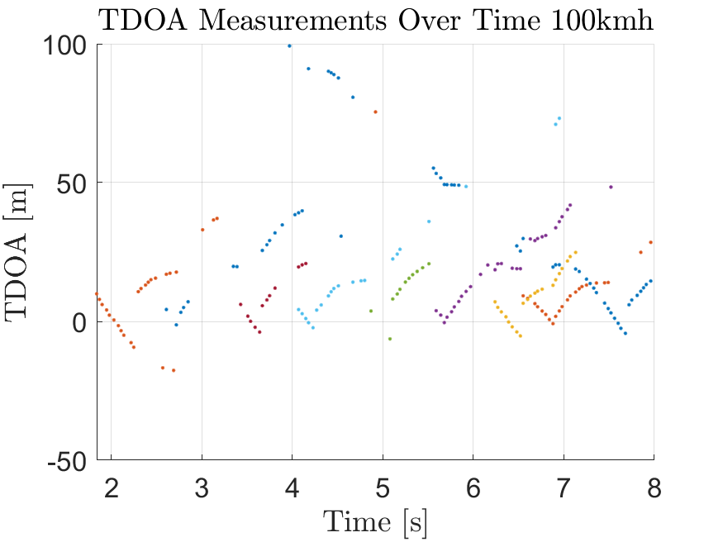
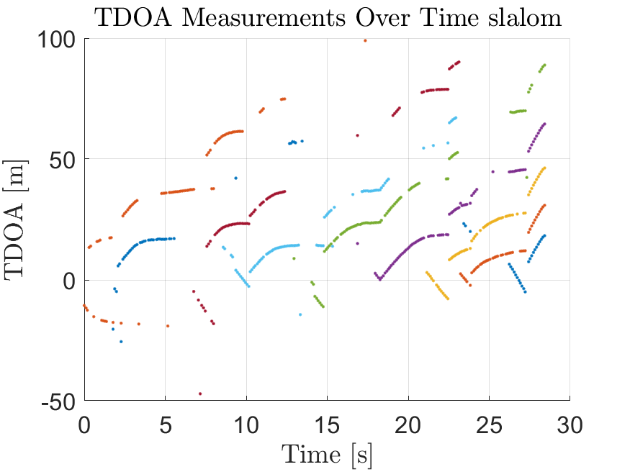
Data Visualization
Secondly, we visualize the TDOA for 3 dataset.
Jiaheng Xiong - DEIB

Slide 4
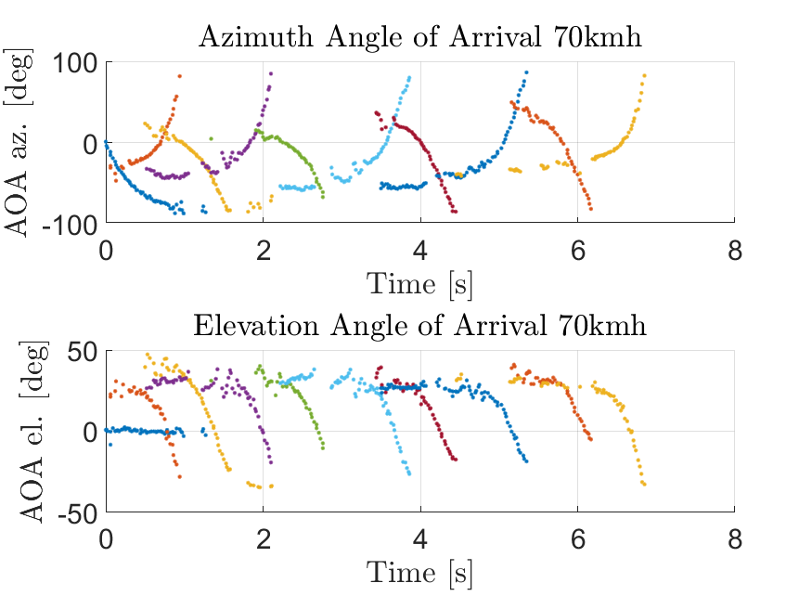
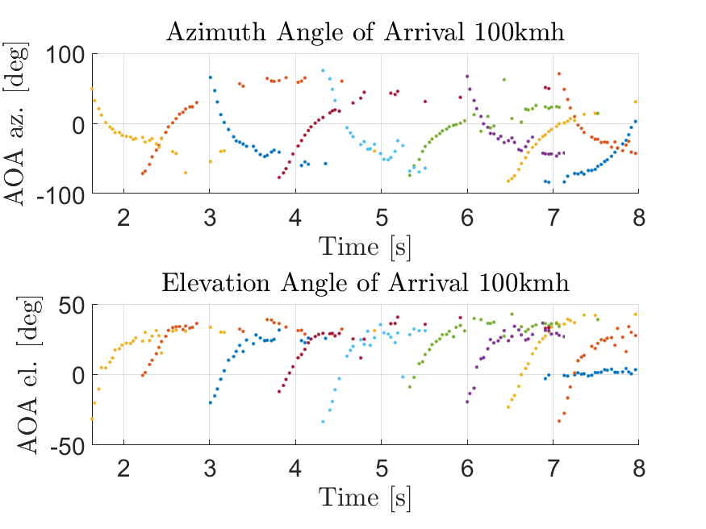
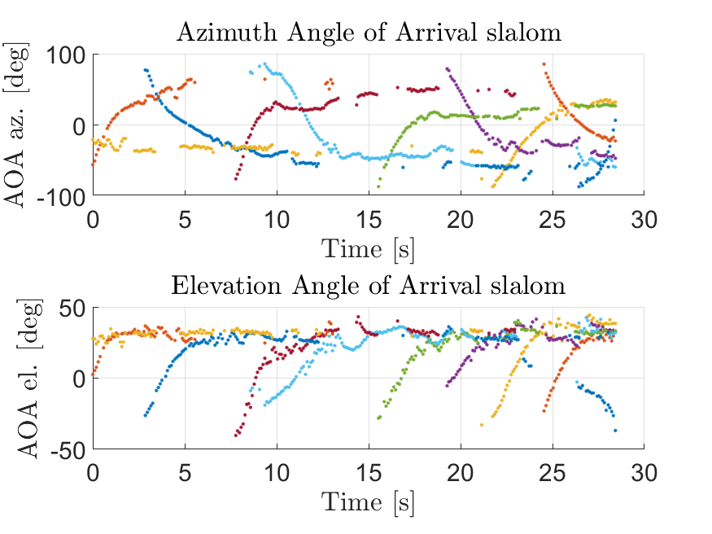
Data Visualization
Thirdly, we visualize the local AOA for 3 dataset.
Jiaheng Xiong - DEIB

Slide 5
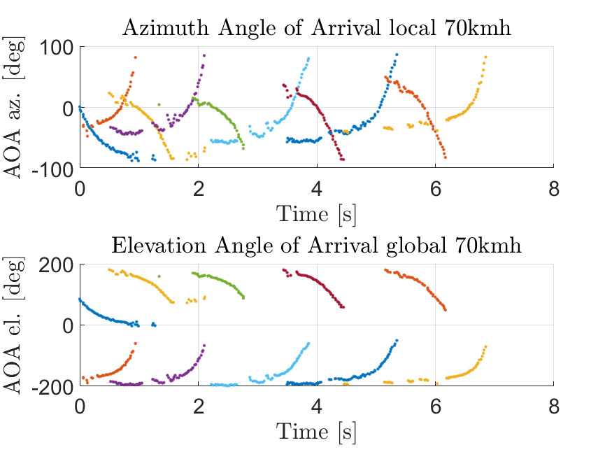
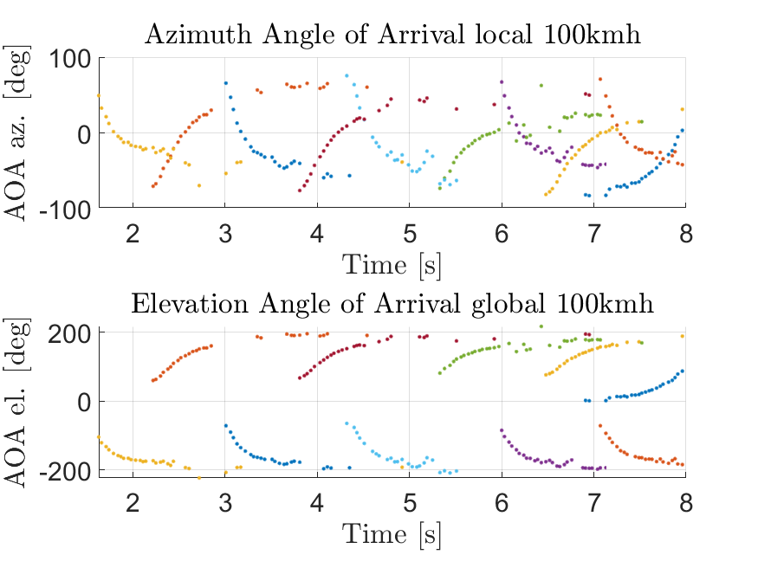
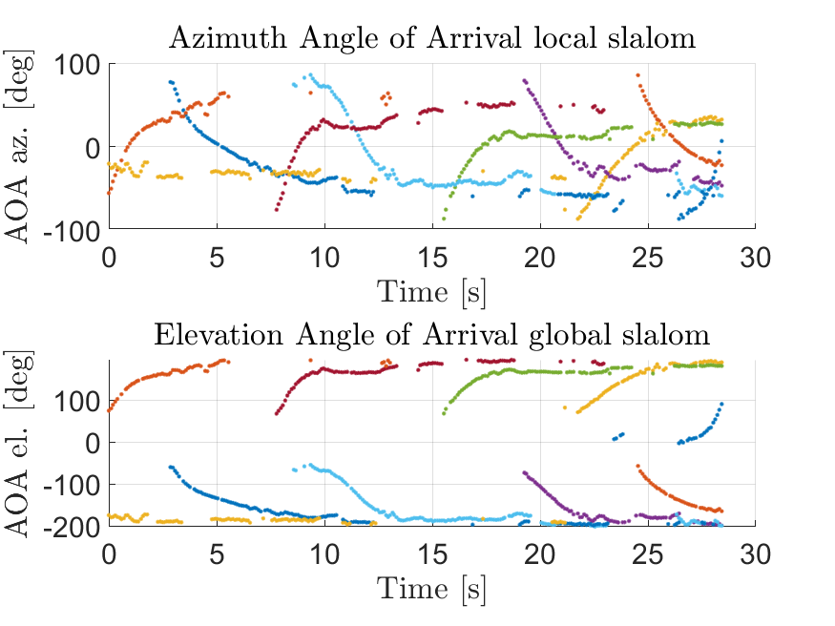
Data Visualization
Finally, we visualize the global AOA for 3 dataset.
Jiaheng Xiong - DEIB

Slide 6
TDOA_NLS
We only consider the TDOA measurement with at least 2 valid data, because we must have 2 or more tdoa to localize a point.
Because there are so much NaN in our dataset, we only use the AP with non-NaN to localize as fig. 1
We delete the outlier result which is outside of the tunnel as fig. 2. Because we think these values are failed.
Estimated Target
NaN
NaN
NaN
NaN
NaN
NaN
NaN
NaN
Fig. 1
Fig. 2
Jiaheng Xiong - DEIB

Slide 7
AOA_NLS
We only consider the AOA measurement with at least 2 valid data, because we must have 2 or more aoa to localize a point.
Because there are so much NaN in our dataset, we only use the AP with non-NaN to localize as the process in TDOA
We find there are some aoa data not reasonable. And the error may be introduced by the signal reflection on the tunnel wall as the fig. 1. We try to retrieve the aoa as the fig. 2. We assume that each AP is tightly attached to the tunnel wall, so this error is negligible.
With the same process of TDOA, we delete the outlier data.
Reflected
Reflected
Fig. 1
Fig. 2
Jiaheng Xiong - DEIB

Slide 8
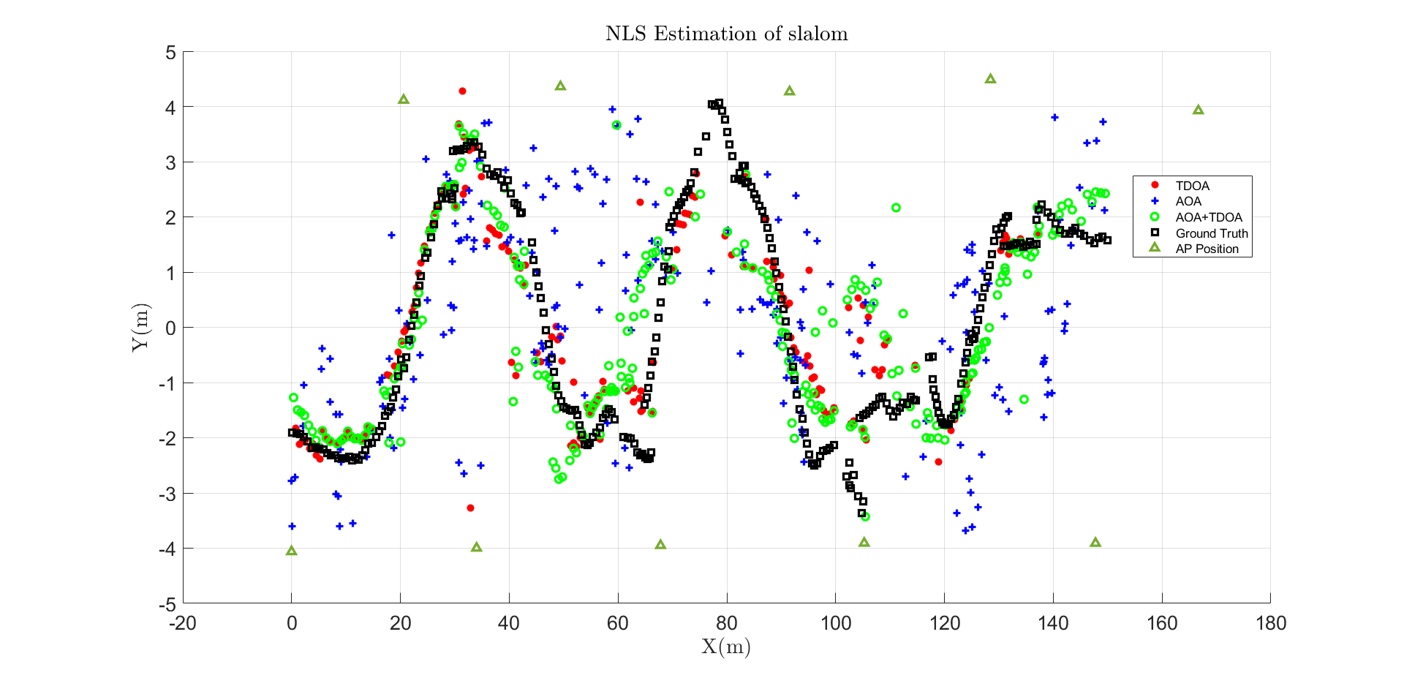
AOA_TDOA_NLS Result of Slalom
We combine the AOA and TDOA localization. And If we have one AOA and one TDOA, we can localize the target. The result of 3 dataset as below.
 | Num valid localization | RMSE
TDOA | 183/286 = 63.99% | 6.9756
AOA | 228/286= 79.72% | 7.7571
AOA+TDOA | 250/286= 87.41% | 2.7947
Jiaheng Xiong - DEIB

Slide 9
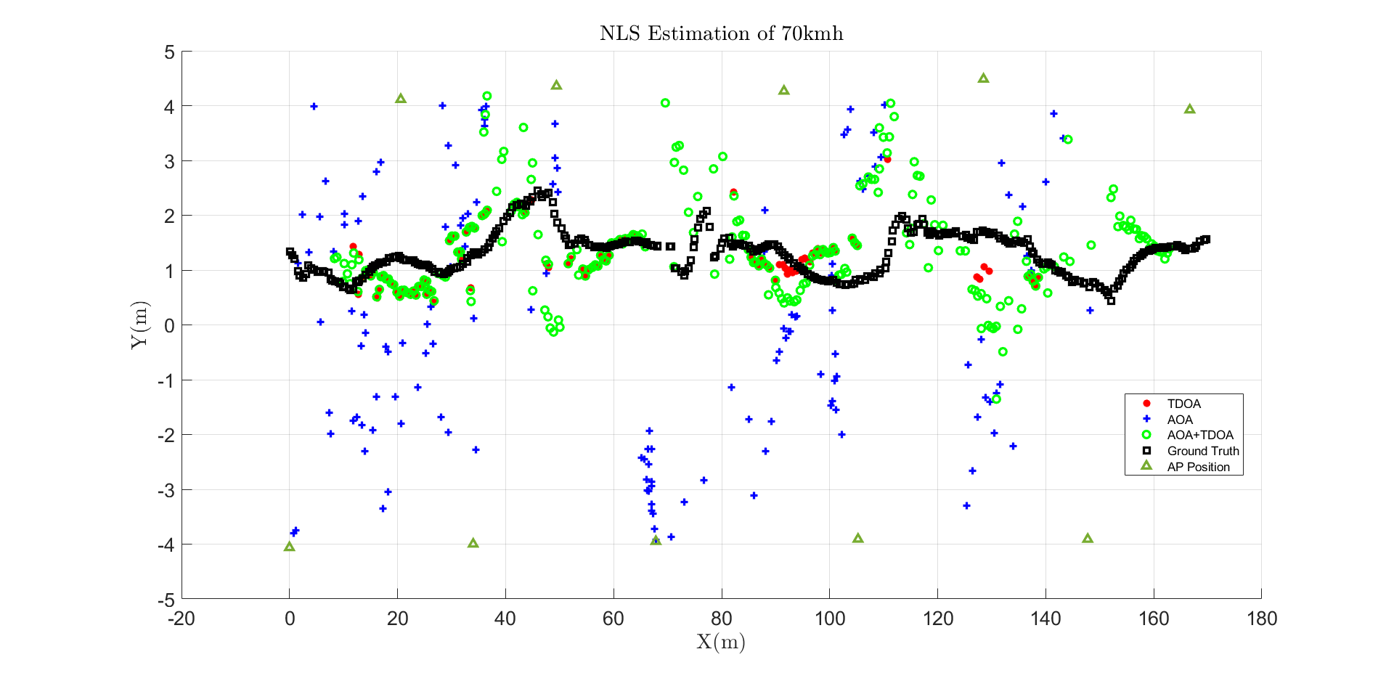
Result of 70kmh
 | Num valid localization | RMSE
TDOA | 120/336 = 35.71% | 0.5606
AOA | 142/336= 41.67% | 4.5543
AOA+TDOA | 256/336= 76.19% | 1.0452
Jiaheng Xiong - DEIB

Slide 10
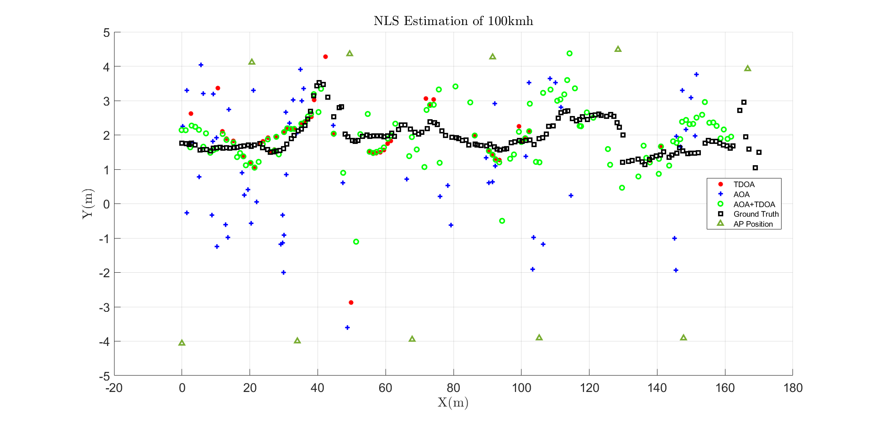
Result of 100kmh
 | Num valid localization | RMSE
TDOA | 47/168 = 27.98% | 1.0072
AOA | 64/168= 38.09% | 8.7185
AOA+TDOA | 117/168= 69.64% | 1.2164
Jiaheng Xiong - DEIB

Slide 11
Analysis of Result
From the result, we can see the AOA+TDOA have the most valid result in each case. And AOA is the second.
We can see AOA has the highest RMSE in each case. It means the measurement of AOA is not accurate.
In the slalom case, the AOA+TDOA has lowest RMSE. In the other cases, TDOA method get the lowest RMSE.
Though in the 70kmh and 100kmh case, the RMSE of AOA+TDOA are not highest, but they are much better than AOA, and near by the performance of TDOA.
So, the conclusion is, AOA+TDOA method has the best performance. It combines the advantage of AOA and TDOA, get the more valid estimation and lower RMSE.
Jiaheng Xiong - DEIB

Slide 12
THANK YOU!
Jiaheng Xiong - DEIB

